Slide 1
JavaScript & TypeScript NXT
#DDDMelb @basarat

Slide 2
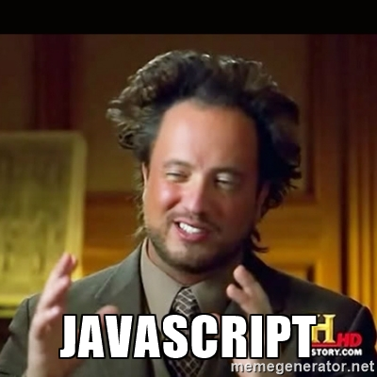

Slide 3
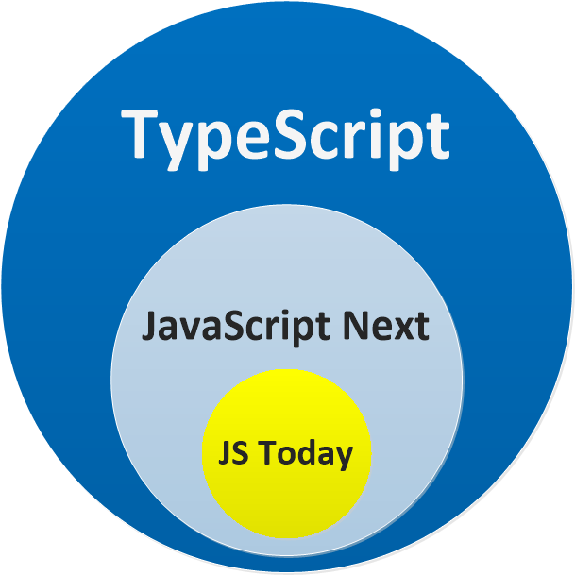

Slide 4
DEMO
Just a JS file
A JS Project

Slide 6


Slide 7


Slide 10
JS : let and Const

Slide 11
QUESTIONS

Slide 12


alm.tools
Google:
TypeScript Book

Slide 13
@basarat

